Slide 1

Transforming IBM HR
IBM| 2024

Slide 2
$2.2B delivered in productivity with Automation & AI
2023
2024
Eliminate. Simplify. Automate.
+AI -> AI+
50%
25%
50%
Automation
AI
75%
Automation
AI
(20+ use cases already in production)
Enterprise Performance Management
Customer Support
IT
Modernization
Digital
Labor
HR Transformation
Automation
watsonx assistant
watsonx.ai
watsonx assistant
IBM Cloud Pak for Data
Turbonomic
Hybrid Cloud
Ansible Automation and watsonx Code Assistant
watsonx assistant watsonx discovery
watsonx Orchestrate
watsonx assistant watsonx discovery
watsonx Orchestrate
$200M in business value
$165M annualized operational savings
$100M+ optimization
80% of top IT issues addressed by AskIT
40% savings in HR operating budget
Notes:
Since January of 2023, with the formation of our Transformation & Operations organization and mission, IBM has delivered $1.6B productivity through automation and AI across the breadth of IBM, on the way to delivering on our $3 B opportunity, which will leverage the full scope of our transformation initiatives.
Whereas we’ve seen automation and AI as technology drivers in equal parts, with explosion of generative AI and watsonx, we expect that ratio to shift over time as our rate of generative AI adoption and implementation accelerates. We have more than 20 more watsonx use cases in development across all domains and functions, and more on the way.
These examples are not all inclusive but highlight areas where we’ve seen and executed on the opportunity to deliver value in our own enterprise.
Our Enterprise Performance Management data and AI platform supports and enables our enterprise-ready integration of end-to-end intelligent workflows, infused with AI. This drives revenue and cost savings.
We’ve modernized our IT infrastructure with Hybrid Cloud; and implemented cognitive tooling into our workflows, by infusing AI into our Salesforce platform, using digital labor to augment employees service for IT, HR and other support areas, and enabling programmers to more rapidly develop application with code with watsonx code assistant and ansible automation.

Slide 3
Transformation Drivers
Internal and external pressures have created forces for change in HR functions worldwide.
HR Transformation
Cost Efficiencies
Compliance
Economic conditions
Return on investment
Regulatory complexity
Country/State/City tailoring
Consumer-grade Experiences
Employee and Manager experiences
Customer service mantra
IBM HR

Slide 4
Transformation is no longer episodic Pragmatic and continuous improvement efforts are the catalyst for big transformational changes
Rethinking HR Transformation
Big Bets
This are large, cross-functional multi-year projects with high return on investment. Often result in new organization design and modernized operating model.
Continuous Improvement
Continuous Improvement
Small
Projects
Small
Projects
Medium Size Projects
Medium Size Projects
(2) Medium Size Projects
Projects that are happening at the HR function org level and include work redesign and automation with medium size impact.
Continuous Improvement
Continuous Improvement
Big Bets
Small
Projects
Small
Projects
Continuous Improvement
Continuous Improvement
(3) Small Projects
Collection of small enhancements that combined drive significant productivity impact.
Medium Size Projects
Medium Size Projects
Small
Projects
Small
Projects
Continuous Improvement
Continuous Improvement
(4) Transformation Culture
HR Professional transforming their own work in a unsupervised manner.
Core HR Mantra:
ELIMINATE
SIMPLIFY
AUTOMATE

Slide 5



Technology as an enabler: The Persona Experience
AI Orchestration Layer for HR powered by watsonx Orchestrate
Employees
Managers
HR Professionals
Engages with digital assistant (AskHR) as the primary entry point into HR
Transaction and HR query assistance
Engages with digital assistant (AskHR) as the primary entry point into HR
Transaction, HR query and complex case assistance
Engages with digital labor as a guide during end-to-end HR processes
Engages with digital labor to pass off low-value manual work, instead focusing on coaching and guiding the business
IBM HR | 2024
5

Slide 6


First Chatbot Launch Cost reduction and efficiency
Our AskHR Transformation Story
General information recall and search
Ticket generation
+ Transactions +Improve the employee experience
Customized information through APIs
Ticket generation
Automated transactions
.
Customized information through APIs
Routing to human tier support
Automated transactions
Mobile
Data driven nudges
Current State + Compliance
Future State
+Generative AI
Hyper-personalized responses
Automatic feedback analysis
Seamless handoffs between AI assistants
2017
2020
2023
2024 →
IBM HR

Slide 7



Reinventing the IBMer Support Model
Digital Tier
AskHR BOT (Level 0)
Containment Rate: 94%
Tiered support model with AskHR as the platform of experience and productivity with a seamless handover to an AskHR advisor when necessary.
Increasing Tier 0 and Tier 1 containment rates allows SMEs to drive higher-value work for HR offerings and business support.
Integrated & Intuitive
Primary Source of Employee Issue resolution
FAQ’s, Policy/HR Web
Task Automation & Simplification
Digital Advisor: auto ticket creation, warm handover to Live Chat & triage to human agent
Human Tier
AskHR Advisor (Level 1)
Live Chat or Webex
Provide high touch support
Complex case resolution
Globalized squad structure
Human Tier
SMEs (Level 2)
Sunset phone support – Modernized approach
HR Function expertise
Upline manager support
IBM HR
© 2023 IBM Corporation

Slide 8

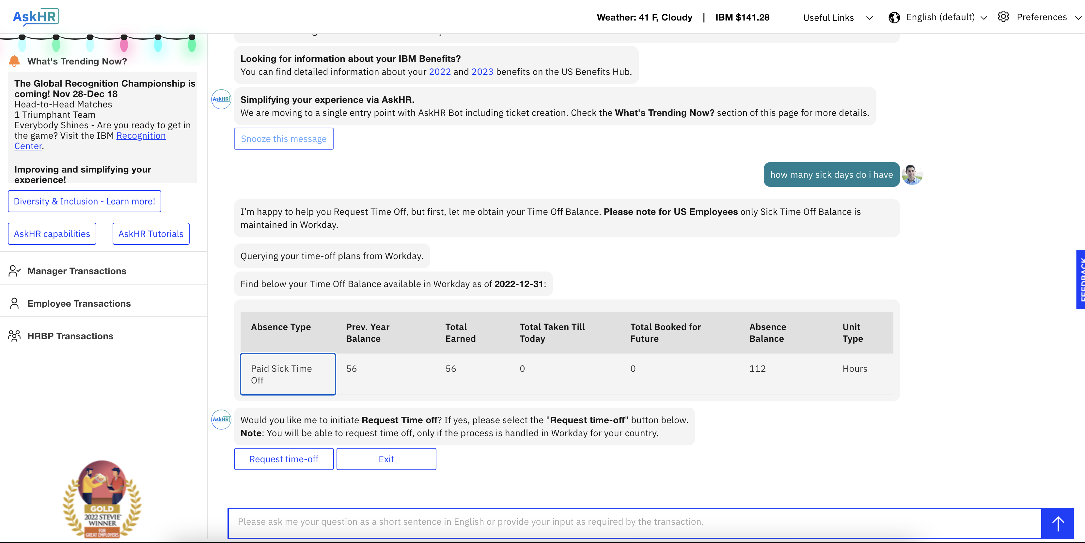
IBM AskHR An HR digital assistant driving a seamless experience for employees and empowering HR professionals to focus on higher value tasks
10.1M
Yearly interactions
765K
Automated Tasks
40%
Reduction in HR Operating Budget
94%
Employee inquiries handled by AskHR
+55
Improvement of HR NPS score from +19 → +74
96%
Manager adoption
93%
Executive adoption
2 Bands
Average increase in HR ‘level’
IBM| 2024

Slide 9
watsonx Orchestrate: AI for HR

Slide 10



























AskHR Architecture: watsonx Orchestrate
Data
IBM Cloud Object Storage
Document Storage
User Interface
Virtual Assistant
HR Policy Documents
Conversational Flow
Continuously Improving Interactive Dialogue
Knowledge Base Search
Resolve Common HR Policy Related FAQs
Possible Integrations
Language Translation
Multilingual Support
Speech-to-Text
Multiple Language Speech Transcription
Users
watsonx orchestrate
Virtual Assistant, Skills Builder & Automation Capabilities
AI
watsonx.ai
Infrastructure Options
On Prem
© IBM 2024
10

Slide 11




















watsonx Orchestrate: AI Assistants for business
Customer Care
Sales
Supply Chain
Procurement
Finance
HR
Use cases
Digital self-serve
Modernize contact center
Agent Assist
Contact Center Insights
Use cases
Buyer experience
Lead management
Opportunity management
Seller support
Use cases
Sourcing Support
Supplier Management
Sustainability
Inventory Management
Use cases
Procure to pay
Contractor requisitions
PO management
Supplier assessment
Use cases
Source to Pay
Order to Cash
Expense Management
Auditing
Financial Reporting
Use cases
Talent Recruitment
Onboarding
Payroll
Compensation
Employee support
Business impact
Better resolution times
Reduced costs
Improved NPS/CSAT
Higher agent retention
Business impact
Higher conversion rate
Increased order size
Improved upselling
Customer retention
Business impact
Cost per order
Lead times
Order cycle time
Business impact
Improved onboarding
Reduced external spend
Improved sourcing
Business impact
Cost per transaction
Days sales outstanding
Time to close period
Business impact
Time to offer
Cost per hire
Reduced support cost
1-click resolution rates
CONVERSATIONAL | ORCHESTRATES SKILLS | CONTEXTUALIZED OMNI-CHANNEL | MULTI-CLOUD
CLASSIFY | GENERATE | SUMMARIZE | EXTRACT
SEMANTIC SEARCH | VECTOR DB
RPA | WORFKLOW | DECISION | DISCOVER EXISTING
Generative AI Skills
Knowledge Skills
Automation Skills
INTEGRATIONS
11
Notes:
The advent of Generative AI and the continued evolution of automation technologies, have ushered in a new wave of customer experience transformation. It sees the emergence of AI Assistants (aka co-pilots) that sits alongside consumers and fast-tracks them to that gratifying self-serve moment – the real outcome that we all seek to offer. These AI Assistants need to work with the variety of back-end systems and processes required to automate experiences. Augmented by Gen AI, these AI Assistants offer a path to deliver personalized, contextualized, and business grounded informational help at every step of the way.
The path to adopt these AI Assistants at scale has been paved from years of experience putting into production AI and Automation.

Slide 12
AskHR

Slide 13
Example AskHR Automations Supporting moments that matter
Moments That Matter:
Receiving Support
Working
Growing
Leading
Changing
Utilizing Workplace Benefits
Obtaining workplace and servicing support
Finding and Utilizing Tools and Information
Booking Travel and Submitting Expenses
Pursuing Learning and Development Opportunities
Documenting Performance and Receiving Recognition
Supporting Role and Career Development
Transitioning to a new or promotional role
AskHR Implemented Use Cases:
Request Time Off
See Vacation Balance
View Compensation History
Retrieve Payslip
Create Employment Letters
Retrieve Tax Forms
Search Colleagues / Direct Reports
Create / View Supervisory Org
Check Claim Status
View Per Diem
Instant messenger notification: Expense transactions
Show Learning Hours
View Badge Details
Search Learning Activities
Recommended Learning Activities
Get historical performance data
Get my earned personal awards
View performance ratings
Instant messenger notification: mid-year performance manager action required
Assign Manager Flag
Initiate Colleague Transfer
Initiate Cost Center Change
IBM HR | 2024
Notes:
Linking their moments to the work that we have done
Amex uses the term Colleagues
Agents = Customer Care Professionals (CCP)
remove maturity curve
How many of these did we cover in AskHR
We think of moments that matter within IBM as well– we need askHR to solve already for some of these– those can become accelerators
Here are some of the moments that matter– playing with messaging and how story will be more powerful
We can accelerate your path
Maturity slide would be different message

Slide 14





Also at work in IBM HR: Digital Labor
Intelligent Orchestration: Engagement with multiple personas in natural language or via events (e.g., emails, triggers, API calls)
Business Context: Remembers past business interactions to make workflows more effective(i.e., it has a long-term memory)
Skills: Out of the box capabilities that can be immediately used to create new workflows and can be added to easily
Use Cases
Quarterly Promotion (HiRo): Learns criteria for promotion and provides managers with selection options: Communicates with managers; 100% loads selections to HRIS. 50,000 manager productivity hours saved per year: 85% HR Business Partner time savings
Expense Audit & Recovery (sHeRlock): Detect fraud through anomalies in expense data; Communicate with managers/employees and handle queries; Setup overpayments, recover funds. Recoveries possible ~$2M ; 6k hours saved for Expense team
Learning Class Management (cHaRlie): Display upcoming classes with low enrollments; View, promote, cancel and communicate classes. 16k Learning Event Manager hours saved; 2k IBMer hours saved through auto-class promotion; Manages 11,000 classes per year
Additional cases include job requisition creation (HeRmione); M&A Employee data integration (HaRmony); Legal compliance in Colorado (wage transparency - HaRper); Return-to-Office Management (HeRmes); Performance Management (HeRcules); Talent Reviews (HactoR): Skills Update.(HarRy)
IBM HR | 2024

Slide 15




Digital Labor Roadmap
Anticipate
Attract
Develop
Engage
HR function areas
HR strategy and planning
Recruiting and resourcing
HR admin and shared services
Compensation and benefits
Learning and development
Performance and career management
Employee engagement
Employee relations
Examples of the application of Generative AI
Mergers & Acquisitions
(HaRmony)
Job Requisition & Posting (HeRmione)
Travel Audit
(sHeRlock)
Learning Management
(cHaRlie)
Promotions Cycle (HiRo)
Workforce Planning/ Internal Career Mobility
Recruitment Tracking - Colorado
(HaRper)
Payroll Alerts
Skills Taxonomy
(HaRry)
Low Performer Management
(HeRcules)
Talent Review
(HactoR)
Executive Promotions
IBM HR

Slide 16

Creating Value: Digitization moves Employees to Higher Value Work
IBM HR Job Hierarchy
2016
2023
Ave. Increase
HR Leader
Band 8-9
HR Partners
0.7
HR Partners
Compensation
1.0
Compensation
Payroll
0.9
Promotions cycle (HiRo)
HR Professional
Band 6-7
HR Support
1.8
Skills Taxonomy
(HaRry)
HR Administrator
Band 3-5
Payroll
HR Support

Slide 17
Talent Acquisition Digital Labor

Slide 19
Assessing Gen AI Readiness
HR Functions | R/Y/G | Intents
Benefits |  | 246
Compensation |  | 472
Performance |  | 181
D&I |  | 93
Global Mobility |  | 487
Onboarding |  | 23
Talent Acquisition |  | 12
Career |  | 214
Majority ready for GenAI
Some intents ready for GenAI
Limited intents ready for GenAI
Complexity (branches)
Documentation quality
AI Ethics
↓
Hybrid AI for HR (Automation + Traditional + Generative AI)
R/Y/G (GenAI) | % of Total
 | 20%
 | 30%
 | 50%
IBM HR | 2024

Slide 20
Hallucination Management
High-Risk Topics​
Static question & answer workflows
High-risk for legal or ethical reasons​
Question and answer are manually curated, therefore, fixed (this is how all Q&A are managed in AskHR today)
Partnering with senior leaders and content owners across HR to identify
All Other Information
Domain-specific gen-AI workflow
Content curation: Content (IBM HR knowledge to be ingested by the LLM) is cleaned up and curated prior to ingestion
LLM Behavioral knobs: Answer discarded if below a threshold level of confidence:
Responds with no answer found message
Offers to escalate to a human agent
Advanced control : Additional methods for managing hallucination and bias will be added based on the multiple rounds of testing
watsonxOrchestrate platform ties the static and dynamic worlds seamlessly

Slide 21
LLM Functionality in AskHR AI Assistant
watsonx Orchestrate
User inputs question
Archer LLM
Decides where to direct question
LLM information is grounded in IBM data​
When necessary, we will limit metadata by variables​
Only role-appropriate information provided/actions taken to ensure relevance and privacy​
Information tagged with metadata e.g. role, location, to enable this and matched with employee profile​
The user doesn’t need to know which automation, digital labor solutions or LLM is needed to answer the questions leading to a seamless interaction​
Does question require an automation to be triggered?
Yes
Automation e.g. Transfer Employee
No
Digital Labor Solutions e.g. HiRo
Domain-Specific AI Assistant
Triggered through description-based routing on a question
Does it require a *static response?
Yes
Provides static response
No
LLM-generated response
*Static response refers to a pre-programmed, non-LLM generated answer. These are used for a questions in which there is only one correct answer.

Slide 22


AI Ethics
Good to Know About AskHR AI Assistant
Coming soon!
The ethics process will ensure that AskHR AI Assistant meets IBM’s standards, reflects its values and provides safeguards for all employees.
The robust process consists of:
Functionality testing and assessment
Legal and ethics review
Implementation of secure guardrails
All AI deployed within HR must follow this process
Why:
Ensures data privacy
Provides accurate advice and guidance
Meets legal and regulatory requirements
Human-centric approach
Open and transparent
Technologically robust
Key Partnerships:
OPRT (Office for Privacy and Responsible Tech)
IBM Ethics board
Legal teams – HR and Global
Works Councils across EMEA
Secure Content: AskHR AI Assistant will only use approved IBM internal data from w3 pages, IBM policies and other internal information. There are no external data sources.
Accuracy and Reliability: Continuous monitoring of correctness and accuracy of answers
Privacy and Access: Interaction with AskHR AI Assistant is validated via SSO and based on your personal access permissions.
Starting from 23rd Sept we will be holding some learning sessions for HR about AI ethics, HR employees’ responsibilities and how to engage us in the ethics process.

Slide 23


























watsonx Orchestrate’s Assistant for HR
Use Case
EMPLOYEE SUPPORT (AskHR)
TALENT RECRUITMENT
ONBOARDING
Metrics
33K
hours saved by self-serviced queries⁷
61%
reduction in tickets raised⁸
$5M
improvement in productivity⁸
84%
decrease in time to hire¹
30%
increase in hires per month²
30%
decrease in year 1 turnover³
12K
hours saved for learning admins⁴
10%
decrease in errors from manual work⁵
88%
reduction in onboard forms completion⁶
Time off management
Employee management
Profile management
Support
Employee verification
Benefits
Compensation
Create job requisition
Find candidates for job requisition
Schedule interview for a candidate
Interview transcript summarization
Email rejection letter to candidate
Create offer packages
Initiate pre-employment checks
Recommend learning for knowledge gaps
Initiate employee onboarding profile creation
Create IT requests
Skill Templates
Pre-built Application Integrations
Notes:
In these 1-sliders, we start to brainstorm the differentiating capabilities for each use case, it’s really tied to the prebuilt skills and apps
The team is actually working on this concept of use case templates using prebuilt skills. So, for example, in the TA use case, creating a job req is one use case, scheduling interviews is another, generating a job offer is another. → NEXT SLIDE
Sources:
IBM Client 0: HeRmoine (30 mins to 5 mins hiring manager time)
https://www.ibm.com/case-studies/sport-clips
3
https://www.ibm.com/case-studies/avid-solutions-international
https://www.ibm.com/case-studies/avid-solutions-international
https://www.ibm.com/case-studies/tricon-steamship-agency
https://www.ibm.com/blogs/think/uk-en/freeing-up-time-for-nhs-frontline-staff-to-focus-on-patients-with-ai-enabled-people-services/?utm_medium=OSocial&utm_source=Linkedin&utm_content=BTDWW&utm_id=LinkedIn-NHSUKIthinkblog-2024-03-21&social_post=sf187195325&sf187195325=1
IBM Client 0: AskHR
IBM Client 0: AskHR

Slide 24



Taxonomy for domain specific Assistants
Domain Specific Assistant
watsonx assistant for *HR
NPI
Use Case Assistant
Employee support assistant
Talent acquisition assistant
NFI
+
+ …
Persona(s)
Employees and managers
Executives
Talent recruiter and hiring manager
Candidate
Use case description
Employees resolve HR related matters efficiently without being an HR expert
Recruiters can quickly source, interview, and help hire new talent
Outcome
Instant and frictionless employee self serve
New talent recruited and retained
ROI
33K
hours saved by self-serviced queries⁷
61%
reduction in tickets raised⁸
$5M
improvement in productivity⁸
84%
decrease in time to hire¹
30%
increase in hires per month²
30%
decrease in year 1 turnover³
High value use case tasks
Time off management
Employee management
Profile management
Support
Employee verification
Benefits
Schedule candidate interview
Interview transcript
Email rejection letter
Create job requisition
Find candidates for job requisition
Technology components needed
Pre-built connectors
Task automations
RAG
Gen AI Automations
Domain prompt libraries
wxo provided
Employee support, Talent aquisition skillflow templates
Add-on
App catalog
Assistant catalog
Gen AI catalog
Notes:
Responsible: Has the duty and the obligation to do the work—as well as the duty to exercise independent judgement to raise appropriate issues
Accountable: Has the authority to decide and is the recipient of any consequences, so there can only be one “A” per process step
Consulted: Must be given the opportunity to influence plans and decisions prior to finalization by the responsible party
Informed: Is informed of progress, key decisions and deliverables by the responsible party

Slide 25
Our HR domain assistants solve multiple use cases, and are modular and additive in nature
watsonx assistant for HR
Domain assistant
Use case
Employee support
Talent acquisition
Tasks to be done (50+)
Time off mgmt
Employee mgmt
Profile mgmt
Support
Employee verification
Benefits
Compensation
and many more…
Conversational flows (custom built)
Guided journeys
Employee flows
Tasks to be done (50+)
Create job requisition
Find candidates for job requisition
Schedule interview for a candidate
Interview transcript summarization
Email rejection letter to candidate
and many more…
Conversational flows (custom built)
Guided journeys
Recruiter flows
Pre-built use case skills and content
Informational help (1000+ topics)
Semantic Search
HR prompts
Gen AI skills
Informational help (1000+ topics)
Semantic Search
HR prompts
Gen AI skills
watsonx Orchestrate
Build custom automations and design skill flows to resolve end to end processes invokable through the AI Assistant
Domain Specific Skill Catalog
Employee support skillflow templates
Builder platform to customize
Talent acquisition skillflow templates
Add-on
App catalog
Assistant catalog
Gen AI catalog powered by watsonx.ai models
IBM Data and AI / © 2024 IBM Corporation
Notes:
So these are the 6 domains we are starting with – we know the first 2 are our bread and butter
We decided these are the core use cases within each domain that we are best-suited for right now (e.g., source to pay in procurement, seller enablement like our own AskSales in Seismic)
What’s our right to win from a technical perspective, how many prebuilt skills do we have for this domain today
And from a GTM / RTM perspective, how well aligned is sales and consulting? Has BPO proven value in this domain?

Slide 26
watsonx Orchestrate vision
NEW – closed beta
watsonx agent
watsonx Orchestrate uses IBM Granite as a LLM-based router with agentic architecture to plug in assistants
Augmented end-user experience
offer 1 single unified entry point for all employees
highly conversational thanks to the power of LLMs
Resulting in higher adoption and engagement
2) Reduced Total Cost of Ownership
reduced development effort to orchestrate multi- assistant experiences
Modular approach allows introduction of new AI assistant/AI agent capabilities over time
AI Assistant for HR
AI Assistant for Sales
AI Assistant for Procurement
AI Assistant for IT
Incentives assistant
…and many more
AI Assistant Builder
Customize AI Assistant to the Enterprise use case leaning on generative AI
Skill Studio
Build custom automations and design skill flows to resolve end to end processes invokable through the AI Assistant
Domain Specific Skill Catalog
Sales Skills
HR Skills
Add-on
Assistant catalog
Procurement Skills
Customer Care Skills
App catalog
Gen AI catalog powered by watsonx.ai models

Slide 27
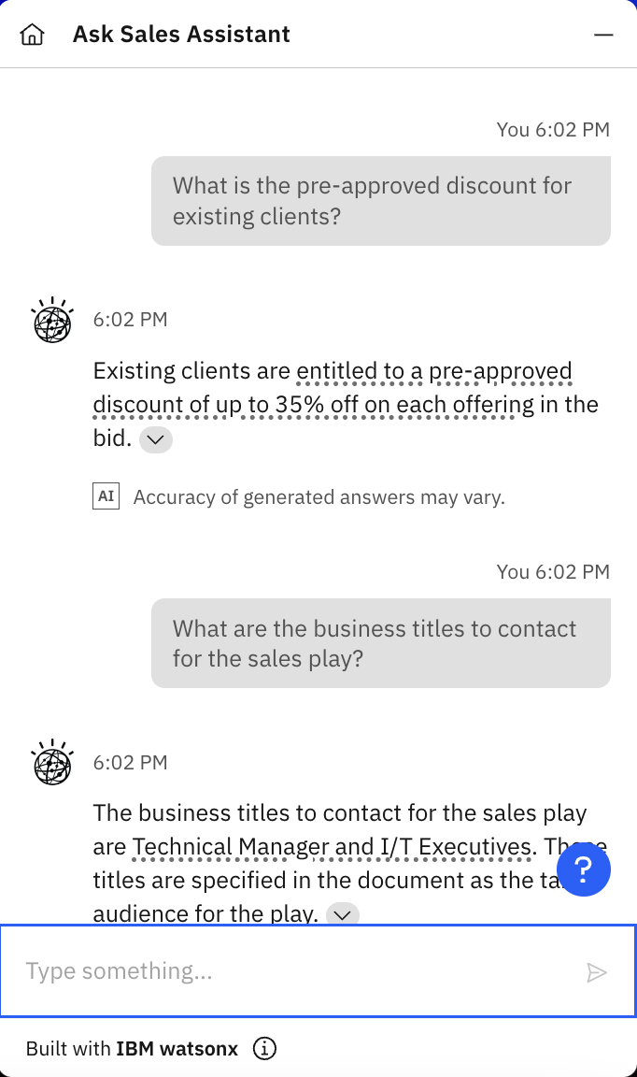
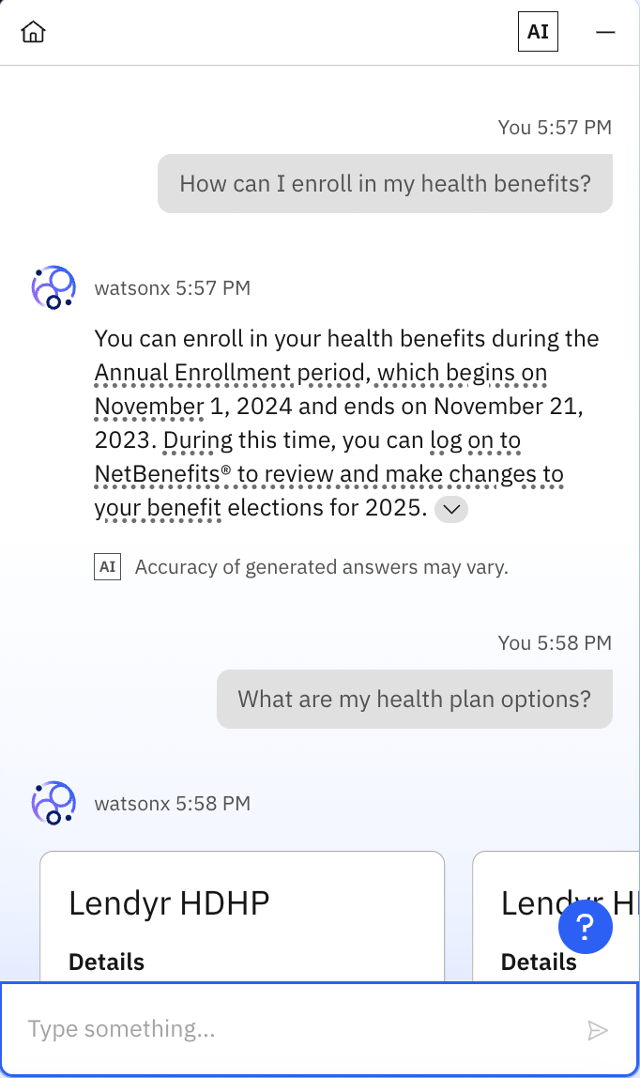
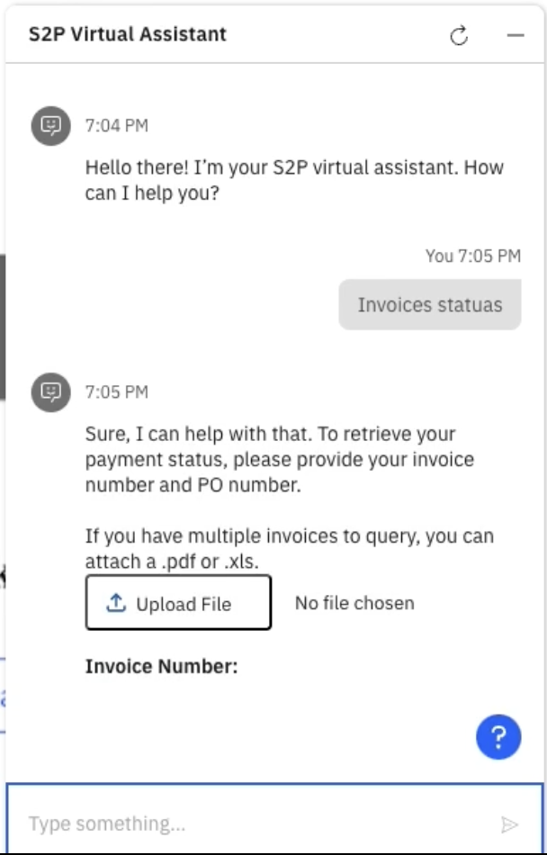
watsonx Orchestrate vision
NEW – closed beta
Unified user interface
watsonx Orchestrate LLM-based router with agentic architecture to plug in IBM watsonx Assistants or 3rd party ones
Launch domain specific Assistants to accelerate your journey of building AI Assistants
Leverage the pre-built skill catalog to launch AI Assistants that come pre-infused with domain relevant integrations, skills and business logic tied to repeatable use cases with high ROI.
RFP assistant
Order assistant
Access tools assistant
Business Partner assistant
Incentives assistant
EPM assistant
AI Assistant for HR
AI Assistant for Sales
AI Assistant for Procurement
…and many more
Expand pre-built domain Assistants with watsonx Orchestrate Skill Studio
Leverage AI Assistant builder and Skill studio to further extend domain specific assistants to go live.
Domain Specific Assistants
Custom team productivity assistant
1
3
AI Assistant Builder
Customize AI Assistant to the Enterprise use case leaning on generative AI
Skill Studio
Build custom automations and design skill flows to resolve end to end processes invokable through the AI Assistant
3. Build new custom Assistants with watsonx Orchestrate Skill Studio
Enterprise teams can build and manage their own custom Catalog of skills and invoke them through AI Assistant interface
Domain Specific Skill Catalog
Sales Skills
HR Skills
Add-on
Assistant catalog
Procurement Skills
Customer Care Skills
App catalog
Gen AI catalog powered by watsonx.ai models
2
IBM watson Orchestrate / © 2024 IBM Corporation
Notes:
We’ve built templates of common HR workflows and made them extensible/customizable (swap apps) – Purchase them in the catalog. Makes it much faster to build domain-specific Assistants.
Can continue to use the platform to build custom Assistants
It all comes together under this unified user interface that allows you to register all of these Assistants
What are these skill catalog add-ons?
we are templatizing the skill flows from our own ibm client 0 and all the depth we’ve built there

Slide 28













































Pre-built skills continue to grow
File Sharing and Hosting
Communication and collaboration
Customer Support
Procurement Automation
Human capital management
Sales Automation
Project management
…Plus many more! Check out the Skill Catalog docs to see all apps and skills
Notes:
Number of prebuilt skills is growing. In July alone, we just released new skills for Asana, Slack, Workday HCM, ZoomInfo, Oracle EBS, InfoBip, Salesloft, and more

Slide 29







Going beyond skills and introducing skill flow templates
Schedule Interview
Notes:
Going from prebuilt skills to skill flow templates
It’s the orchestration of multiple things – API calls to external systems, decision automations, gen AI automations – all those tied together that drives real ROI.
We say they’re extendable because think about how easy it is to swap our Workday for SAP SF in this flow in wxO. No-code, clicking buttons.

Slide 30
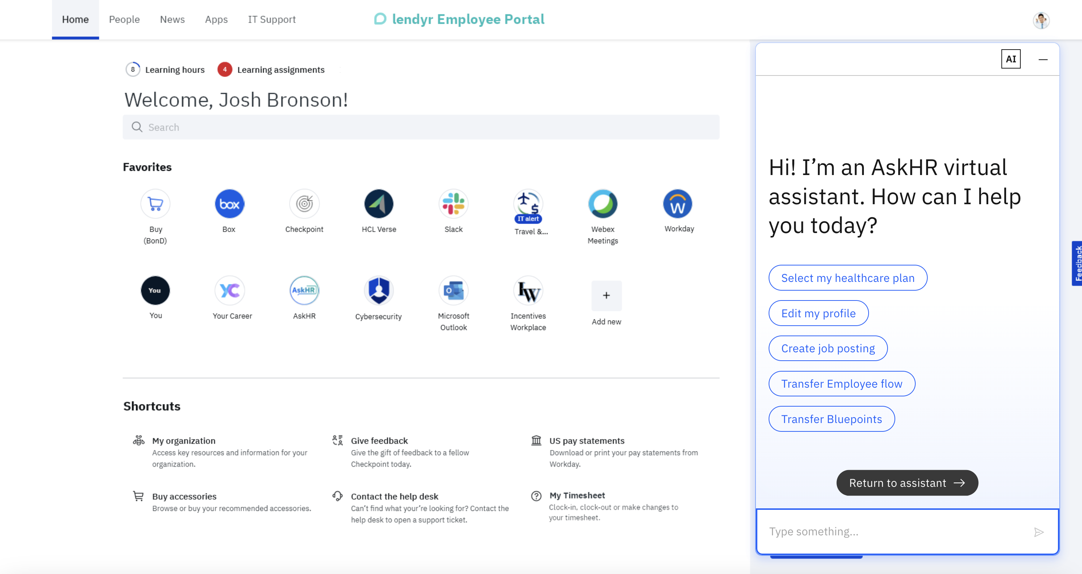
Lendyr AskHR Demo
https://cloud-object-storage-cos-static-web-hosting-9uc.s3.us-east.cloud-object-storage.appdomain.cloud/index.html
https://ibm.ent.box.com/notes/1524598514035?s=7pw17drxnbopnjmux7xnrl8eyrrj97d8

